Slide 1
Capstone Project-3
Credit Card Default Prediction
Jayesh

Slide 2
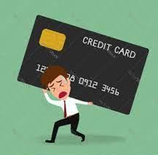
Flow of Presentation
Agenda
Data Summary
EDA
Data Preprocessing
ML models
Conclusion

Slide 3

Agenda
The objective of this project is to predict which customer might default in coming months.
This project aims at developing a model to predict the credit card default beforehand and to identify the potential customer base that can be offered various credit instruments so as to invite minimum default.
Data Cleaning
Feature selection
Model Building
Optimal model
EDA
Null values
Duplicated values
Outliers
Categorical data
Answering hypothesized question
Finding correlation
Statistical modelling for feature selection
Logistic Regression
Decision tree
Random forest
KNN

Slide 4
Data Summary
ID: ID of each client
credit_limit: Amount of given credit in NT dollars
gender: Gender (1 = male, 2 = female)
education: (1 = graduate school, 2 = university, 3 = high school, 0,4,5,6 = others)
marital_status: Marital status (0 = others, 1 = married, 2 = single, 3 = others)*age: Age in years
Scale for PAY_0 to PAY_6:
(-2, -1, 0 = paid duly, 1 = payment delay for one month, 2 = payment delay for two months, ... 8 = payment delay for eight months, 9 = payment delay for nine months and above)
payment_status_sept: Repayment status in September, 2005 (scale same as above)
payment_status_aug: Repayment status in August, 2005 (scale same as above)
payment_status_jul: Repayment status in July, 2005 (scale same as above)
payment_status_jun: Repayment status in June, 2005 (scale same as above)
payment_status_may: Repayment status in May, 2005 (scale same as above)
payment_status_apr: Repayment status in April, 2005 (scale same as above)

Slide 5
Data Summary
bill_sept: Amount of bill statement in September, 2005 (NT dollar)
bill_aug: Amount of bill statement in August, 2005 (NT dollar)
bill_jul: Amount of bill statement in July, 2005 (NT dollar)
bill_jun: Amount of bill statement in June, 2005 (NT dollar)
bill_may: Amount of bill statement in May, 2005 (NT dollar)
bill_apr: Amount of bill statement in April, 2005 (NT dollar)
payment_amount_sept: Amount of previous payment in September, 2005 (NT dollar)
payment_amount_aug: Amount of previous payment in August, 2005 (NT dollar)
payment_amount_jul: Amount of previous payment in July, 2005 (NT dollar)
payment_amount_jun: Amount of previous payment in June, 2005 (NT dollar)
payment_amount_may: Amount of previous payment in May, 2005 (NT dollar)
payment_amount_apr: Amount of previous payment in April, 2005 (NT dollar)
default_payment: Default payment, our target variable (1=yes, 0=no)
In our dataset we got customer credit card transaction history for past 6 months, on basis of which we have to predict if customer will default or not.**

Slide 6
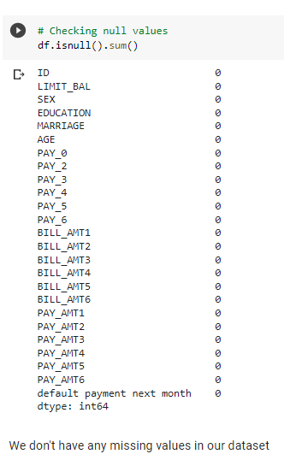
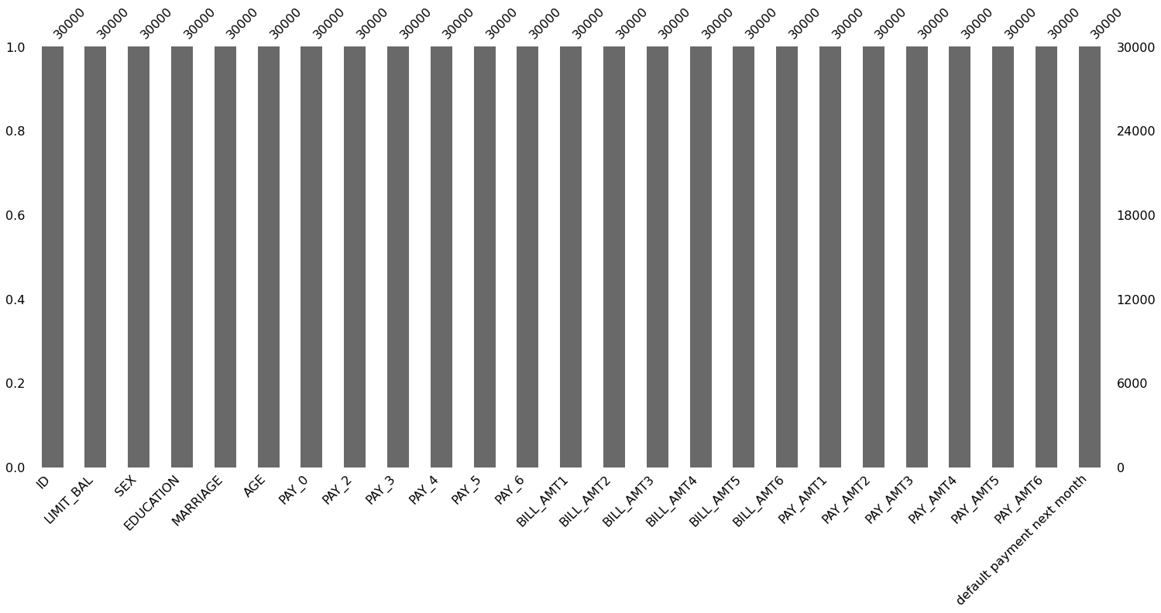
Cleaning of dataset (Null Values)
No null values
No duplicated values

Slide 7
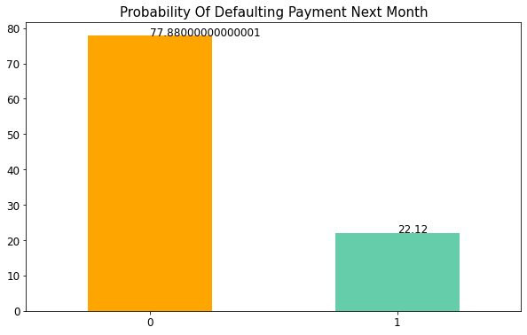
Data Visualization
There is a huge difference between both classes so we have to work on this class imbalance.
About 22% people are expected to default next month and 77.8% are not expected to default

Slide 8
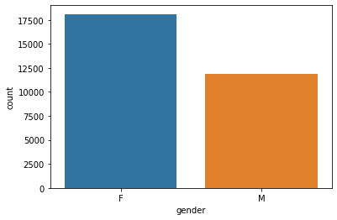
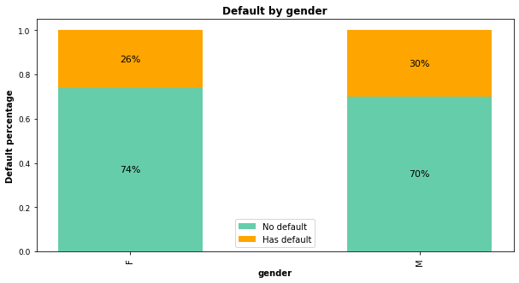
Credit Card holders according to gender
The rate of being defaulter in males is 30% and 26% in female.

Slide 9
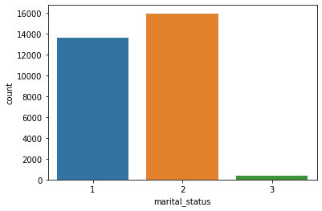
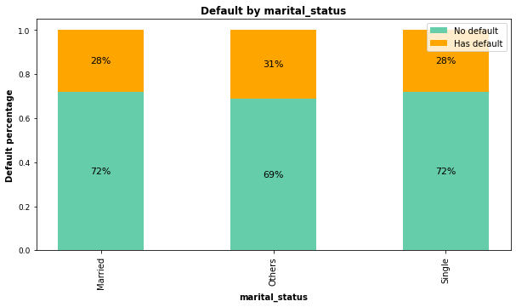
Martial Status
1: Married
2: Single
3: Others
The proportion of being defaulters is quite consistent across marital status categories. Marital status is not much related to the defaulter rate.

Slide 10
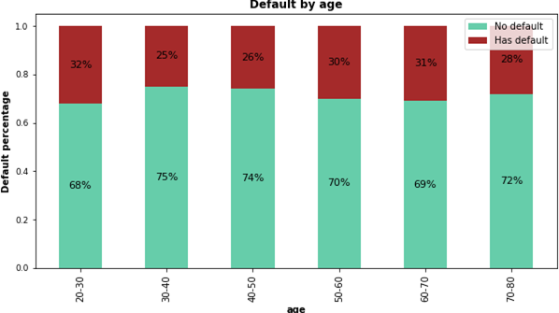
Default by Age
Customers aged between 30-50 had the lowest delayed payment rate, while younger groups (20-30) and older groups (50-70) all had higher delayed payment rates.

Slide 11
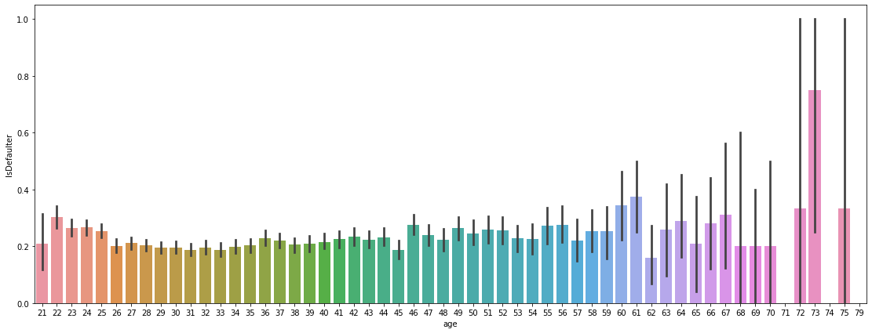
Default by Age

Slide 12
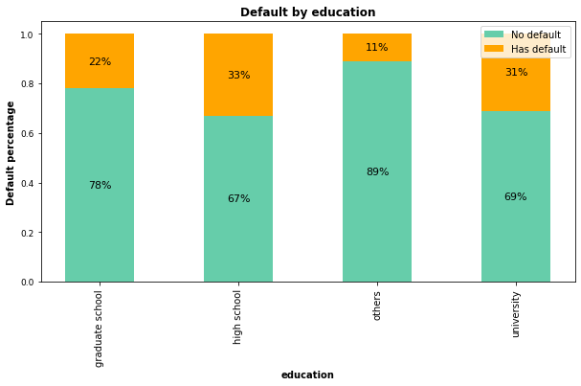
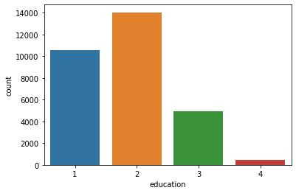
Education
1: Graduate School
2: University
3: High School
4: Others
Majority of the users are university students counting to around 47% of total counts.

Slide 13
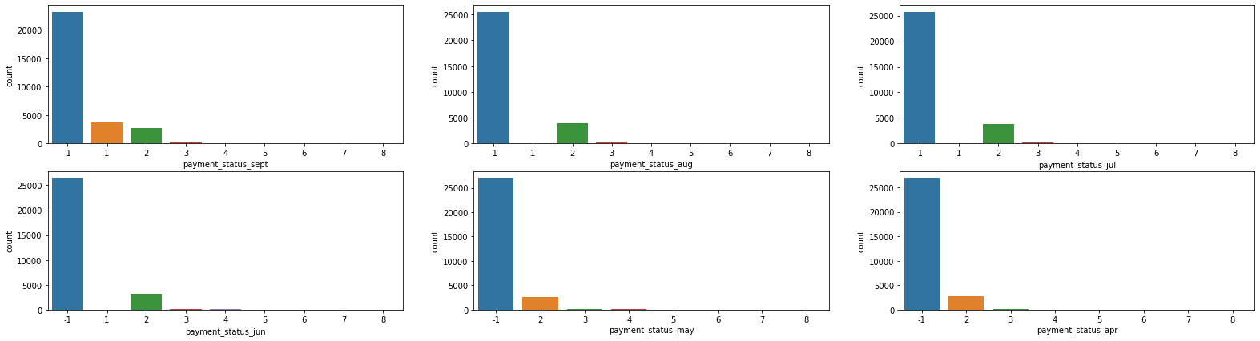
Payment Delay
-1 = pay duly; 1 = payment delay for one month; 2 = payment delay for two months; . . .; 8 = payment delay for eight months; 9 = payment delay for nine months and above

Slide 14
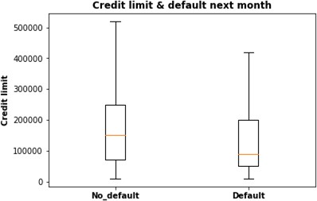
Default rate based on credit limits
Customers with high credit limits tend to pay the pay on time and hence are not defaulters.

Slide 15
Insights- EDA
About 22% people are expected to default next month and 77.8% are not expected to default.
there were more female defaulter but the rate of being defaulter is comparatively higher in males with 30% of total defaulters compared to 26% of female defaulter respectively.
there is quite similar distribution of defaulters in each category indicating marital status does not influence
the defaulter customers.
Customers with high school and university educational level had higher default percentages than customers with grad school education.
people with higher education levels get higher credit limits.
Maximum credit limit was 50000 NT dollars.
Customers aged between 30-50 had the lowest delayed payment rate. They have higher credit limit and tend to ben non defaulter.

Slide 16
Insights- EDA
We have negative bills in the dataset. The average negative amount is 1698 NDT which is very less when comparing with total bill amount of each month so we can guess that this would be refunds from the last billing cycles.
the bill statement amount shouldn't exceed credit limit, however, there are 3931 customers whose bill
amounts are greater than credit limit. May be the difference is due to late payment interest, assuming these customers had delayed payment.
There are 870 customers who didn’t used their card in last 6 months.

Slide 17
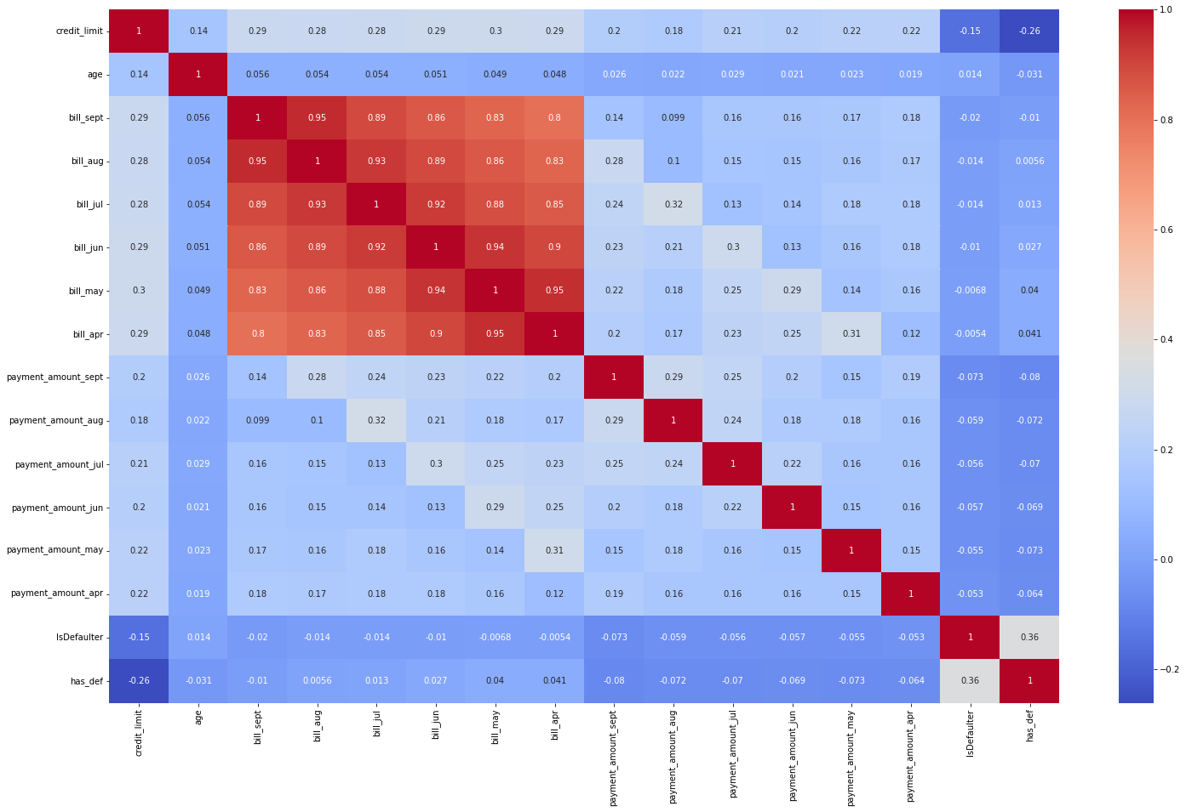
Correlation

Slide 18
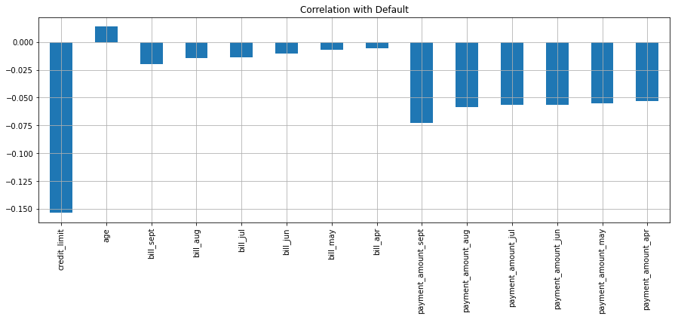
Pearson: standard correlation coefficient

Slide 19
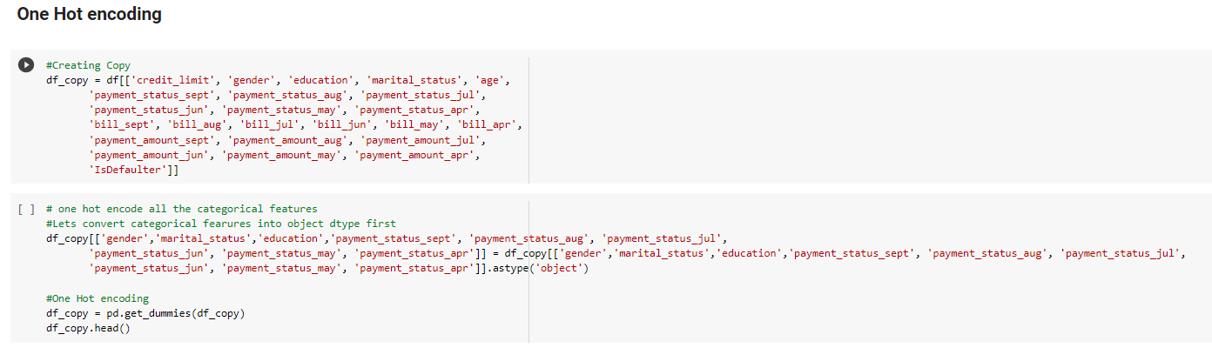
Data Preprocessing
Creating dummy variables for categorical variables using one hot encoding.
A one hot encoding allows the representation of categorical data to be more expressive.
Many machine learning algorithms cannot work with categorical data directly.
The categories must be converted into numbers.
This is required for both input and output variables that are categorical

Slide 20
Models used
Logistic Regression
Decision Tree
Random Forest
K Nearest Neighbor

Slide 21
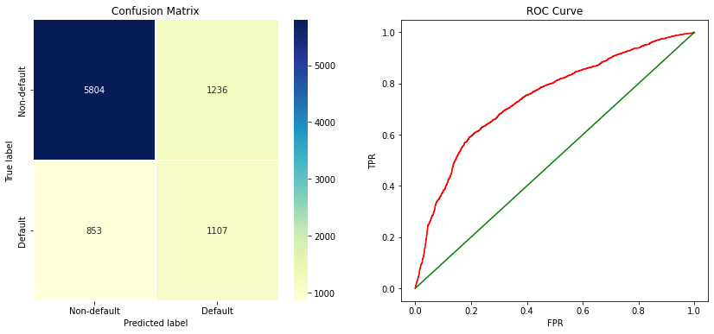
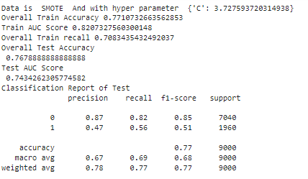
Evaluation Metrics - Logistic Regression Model
H Y P E R P A R A M E T E R
'C': 3.727593720314938

Slide 22
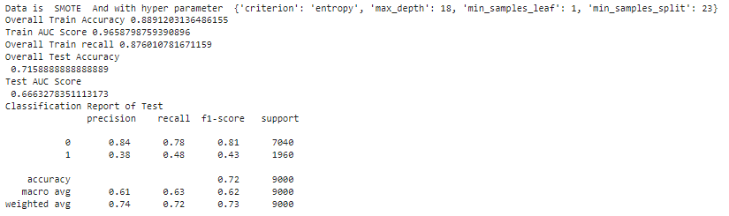
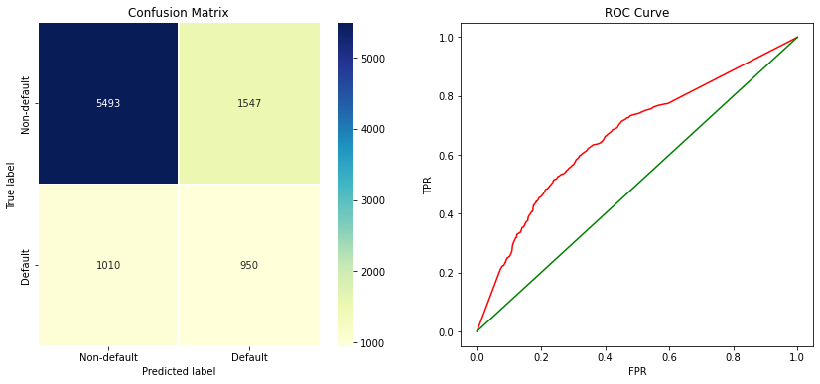
Evaluation Metrics - Decision Trees
H Y P E R P A R A M E T E R
'criterion': 'entropy',
'max_depth': 18,
'min_samples_leaf': 1,
'min_samples_split': 23

Slide 23
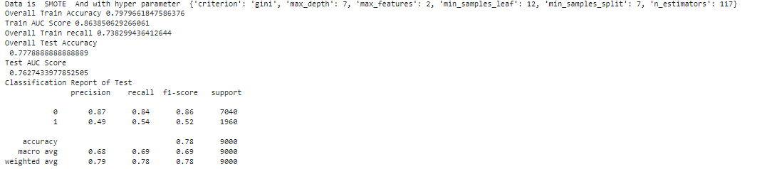

Evaluation Metrics - Random Forest
H Y P E R P A R A M E T E R
'criterion': 'gini’
'max_depth': 7,
'max_features': 2,
'min_samples_leaf': 12,
'min_samples_split': 7,
‘n_estimators': 117

Slide 24
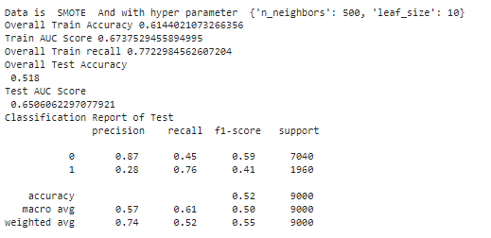
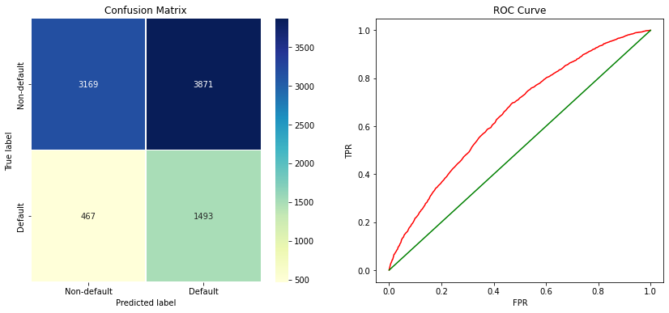
Evaluation Metrics - KNN Algorithm
H Y P E R P A R A M E T E R
‘n_neighbour’ :’500’
‘leaf_size’: ‘10’

Slide 25
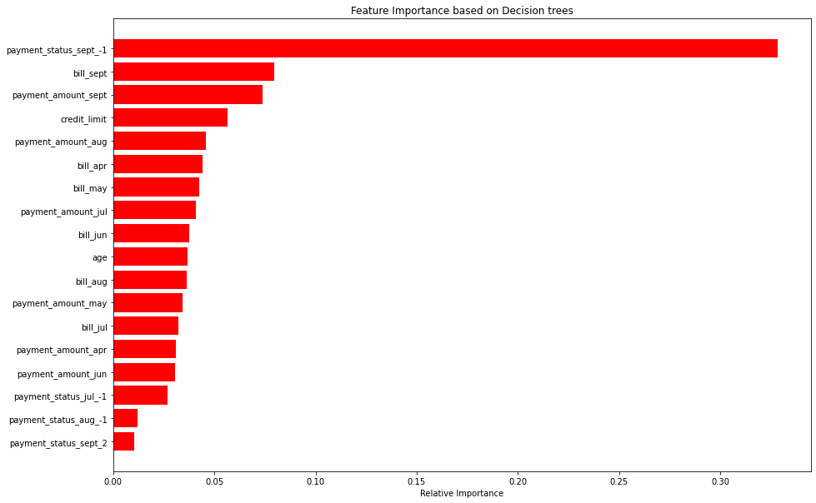
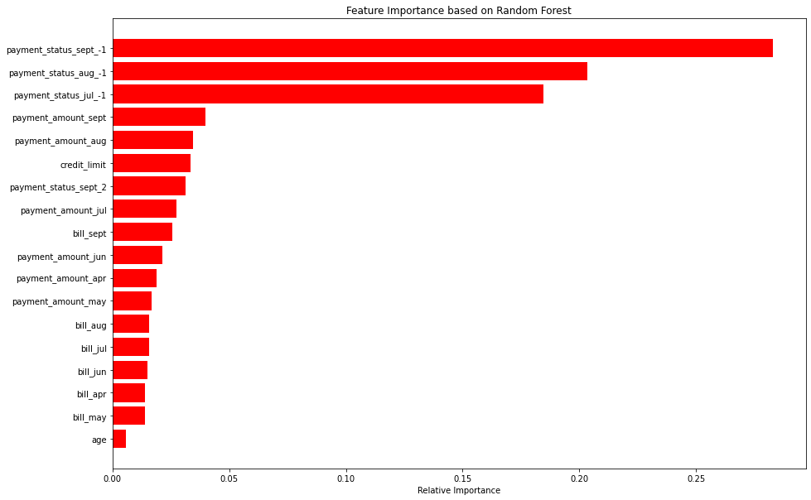
Feature Importance – Tree based model
Payment status of September has given highest importance

Slide 26
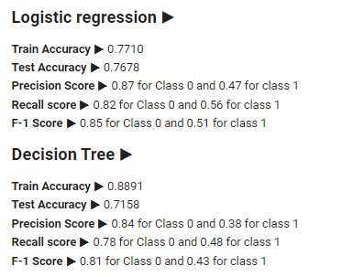
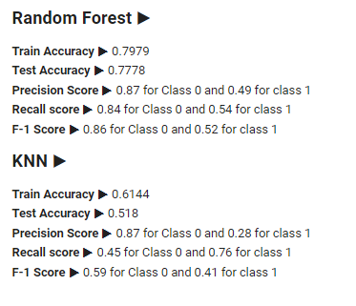
Summary

Slide 27
Conclusion
As the company can not afford the False Negative so main metric to compare all algorithm is Recall metric.
Logistic Regression had an imbalance in the recall score of about 82% for class 0 and 56% for class 1.
Performance on Decision Tree is comparatively better. Decision Trees have recall scores of 78%(class 0) , 48%(class 1).
Imbalanced data was balanced using SMOTE sampling technique.
Data categorical variables had minority classes which were added to their closest majority class
There were not huge gap but female clients tended to default the most.
Random forest have the highest test accuracy with 77%.

Slide 28



THANK YOU

